Slide 1

Maxwell–Boltzmann Speed Distributions
Yuxuan Zhang
Yiyi Liang
29.07.2026

Slide 2




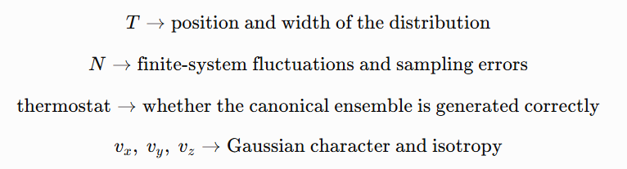
1. Introduction
The Gaussian distribution is
The Maxwell–Boltzmann speed distribution is
Here,
where R is the gas constant, T is the absolute temperature, and M is the molar mass of the particles.
What do we want to discuss?

Slide 3

2. Procedure and Methods
Error analysis
Relative error
Variance
Kolmogorov–Smirnov deviation
The Kolmogorov–Smirnov deviation was used to compare the entire simulated distribution with the theoretical distribution:
Here:
FMD: is the empirical cumulative distribution function obtained from the simulation data;
Ftheory: is the theoretical Gaussian or Maxwell cumulative distribution function.
Extraction of the Equilibrated Part of the Trajectory
Choice of Initial Conditions and Time Step
All data were subjected to quantitative error analysis.
3. Results and Discussion
verification of the equilibrium velocity distribution
comparison of different temperatures
comparison of different particle numbers
characterization of small-system effects
comparison of different thermostats

Slide 4
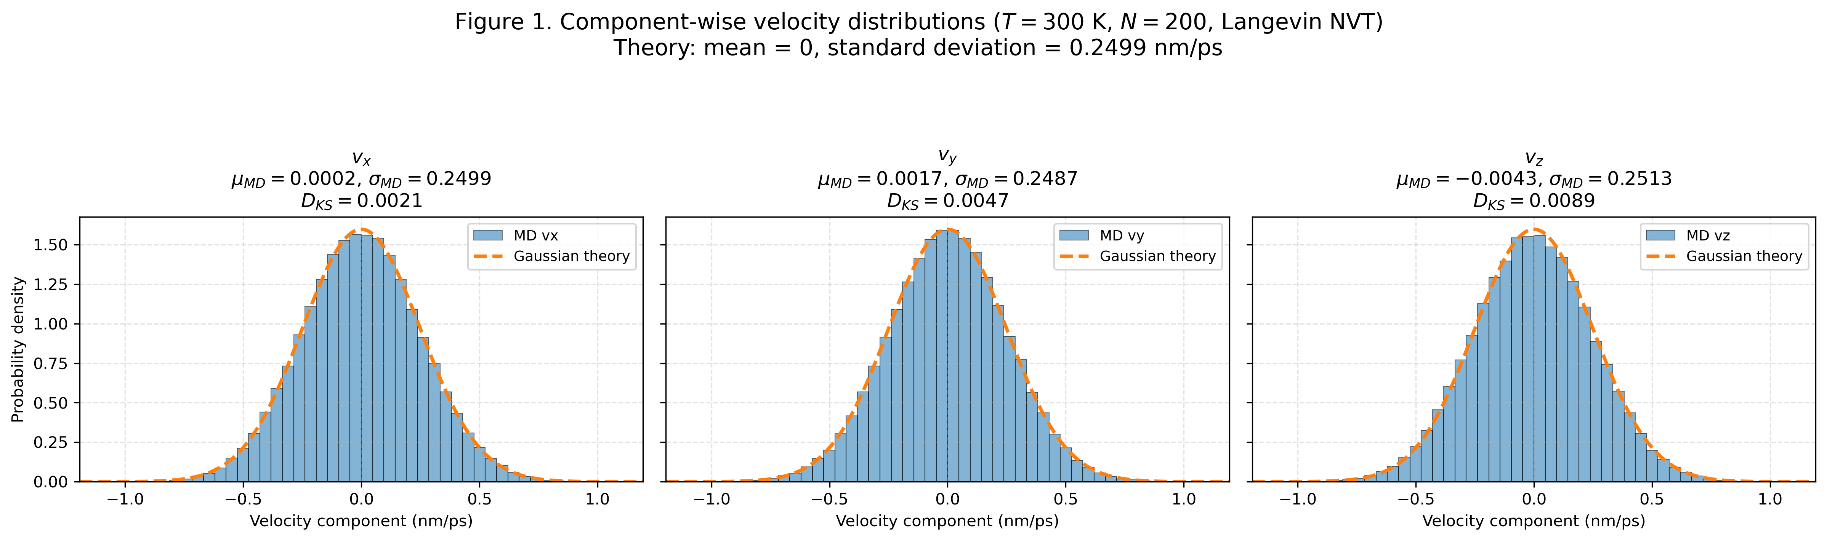
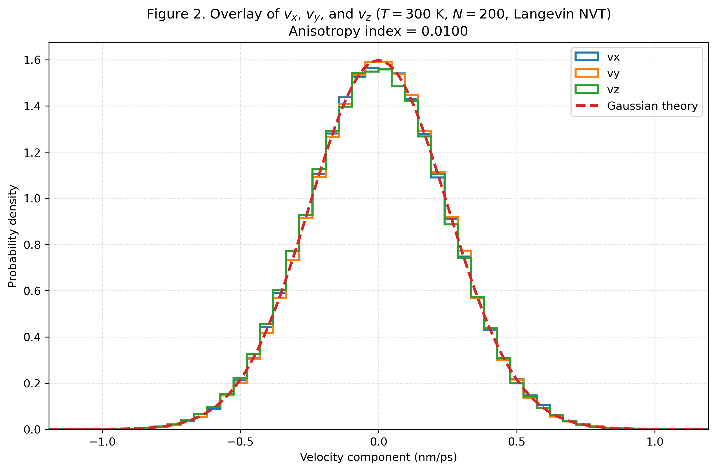

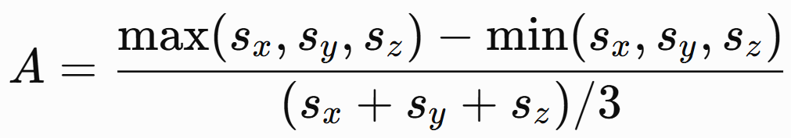

3.1. Analysis of the Cartesian Velocity Components
At thermal equilibrium, each Cartesian velocity component follows a Gaussian distribution. Its probability density is
where
The anisotropy index was defined
where
small A: the system is approximately isotropic;
large A: the widths of the velocity distributions differ significantly among the three directions.
The distributions of vx, vy, vz were all approximately Gaussian with mean values close to zero.
The three distributions were also mutually consistent, indicating that the system was isotropic.
The near-zero mean values show that there was no significant net drift of the entire system.

Slide 5
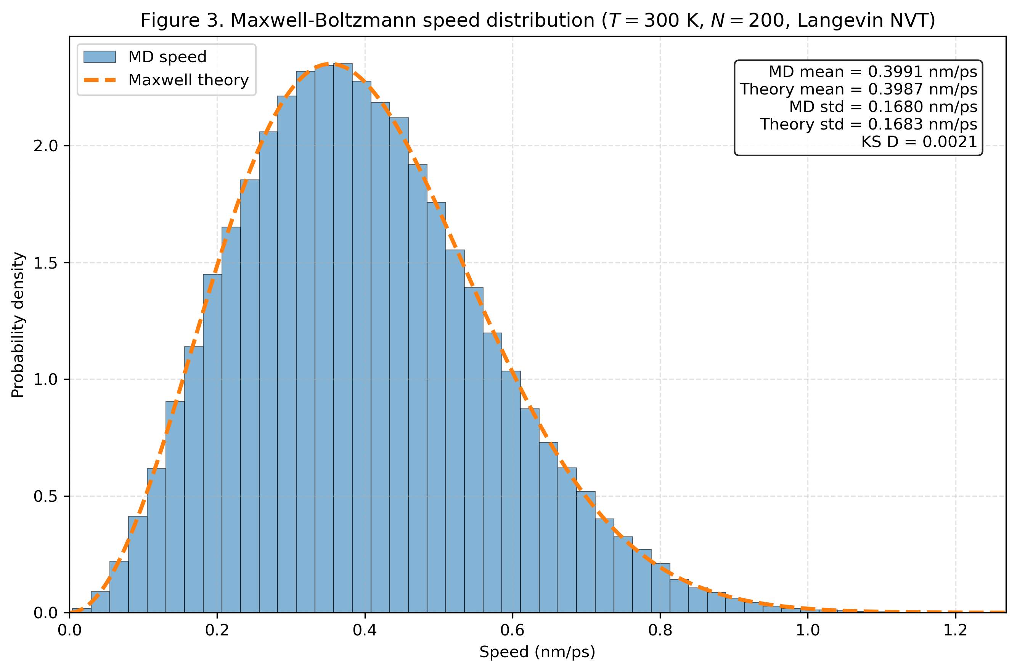




3.1. Basic Validation of the Total Speed Distribution
The particle speed is defined as
The Maxwell speed probability density is
where
The theoretical mean speed is
and the theoretical standard deviation of the speed is
The speed distribution obtained from the MD simulation was consistent with the theoretical Maxwell distribution.

Slide 6
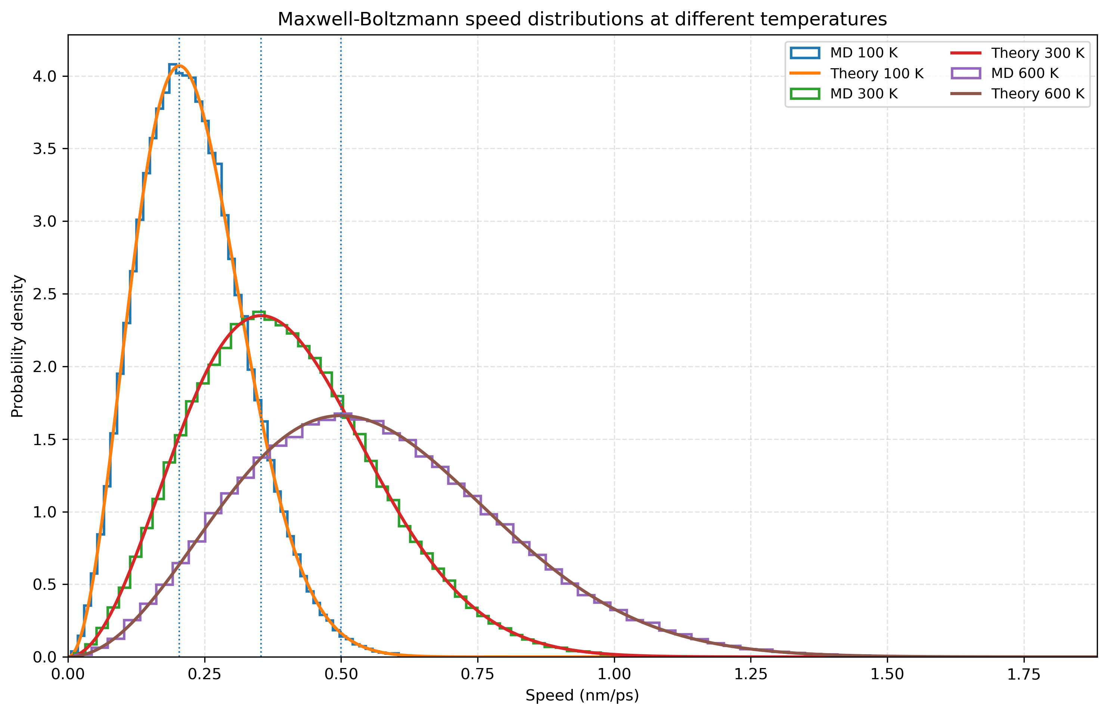


3.2. Temperature Effects
For the same particle species, the scale parameter of the Maxwell distribution is
Therefore, all characteristic quantities describing the position and width of the speed distribution are proportional to
As the temperature increases:
the distribution becomes broader;
the peak shifts to the right;
the peak height decreases;
the high-speed tail becomes longer.

Slide 7
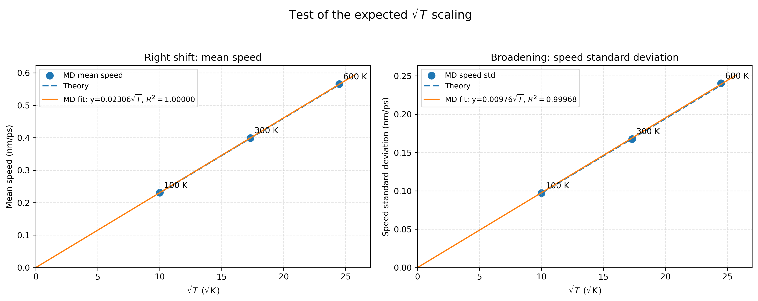



3.2. Temperature Effects
Shift towards Higher Speeds
The shift of the distribution can be quantified using either the mean speed or the most probable speed.
The mean speed is
and the most probable speed is
Broadening of the Distribution
The broadening of the distribution can be quantified using the standard deviation of the speed:
The standard deviation increases with temperature, and the speed distribution becomes broader.

Slide 8
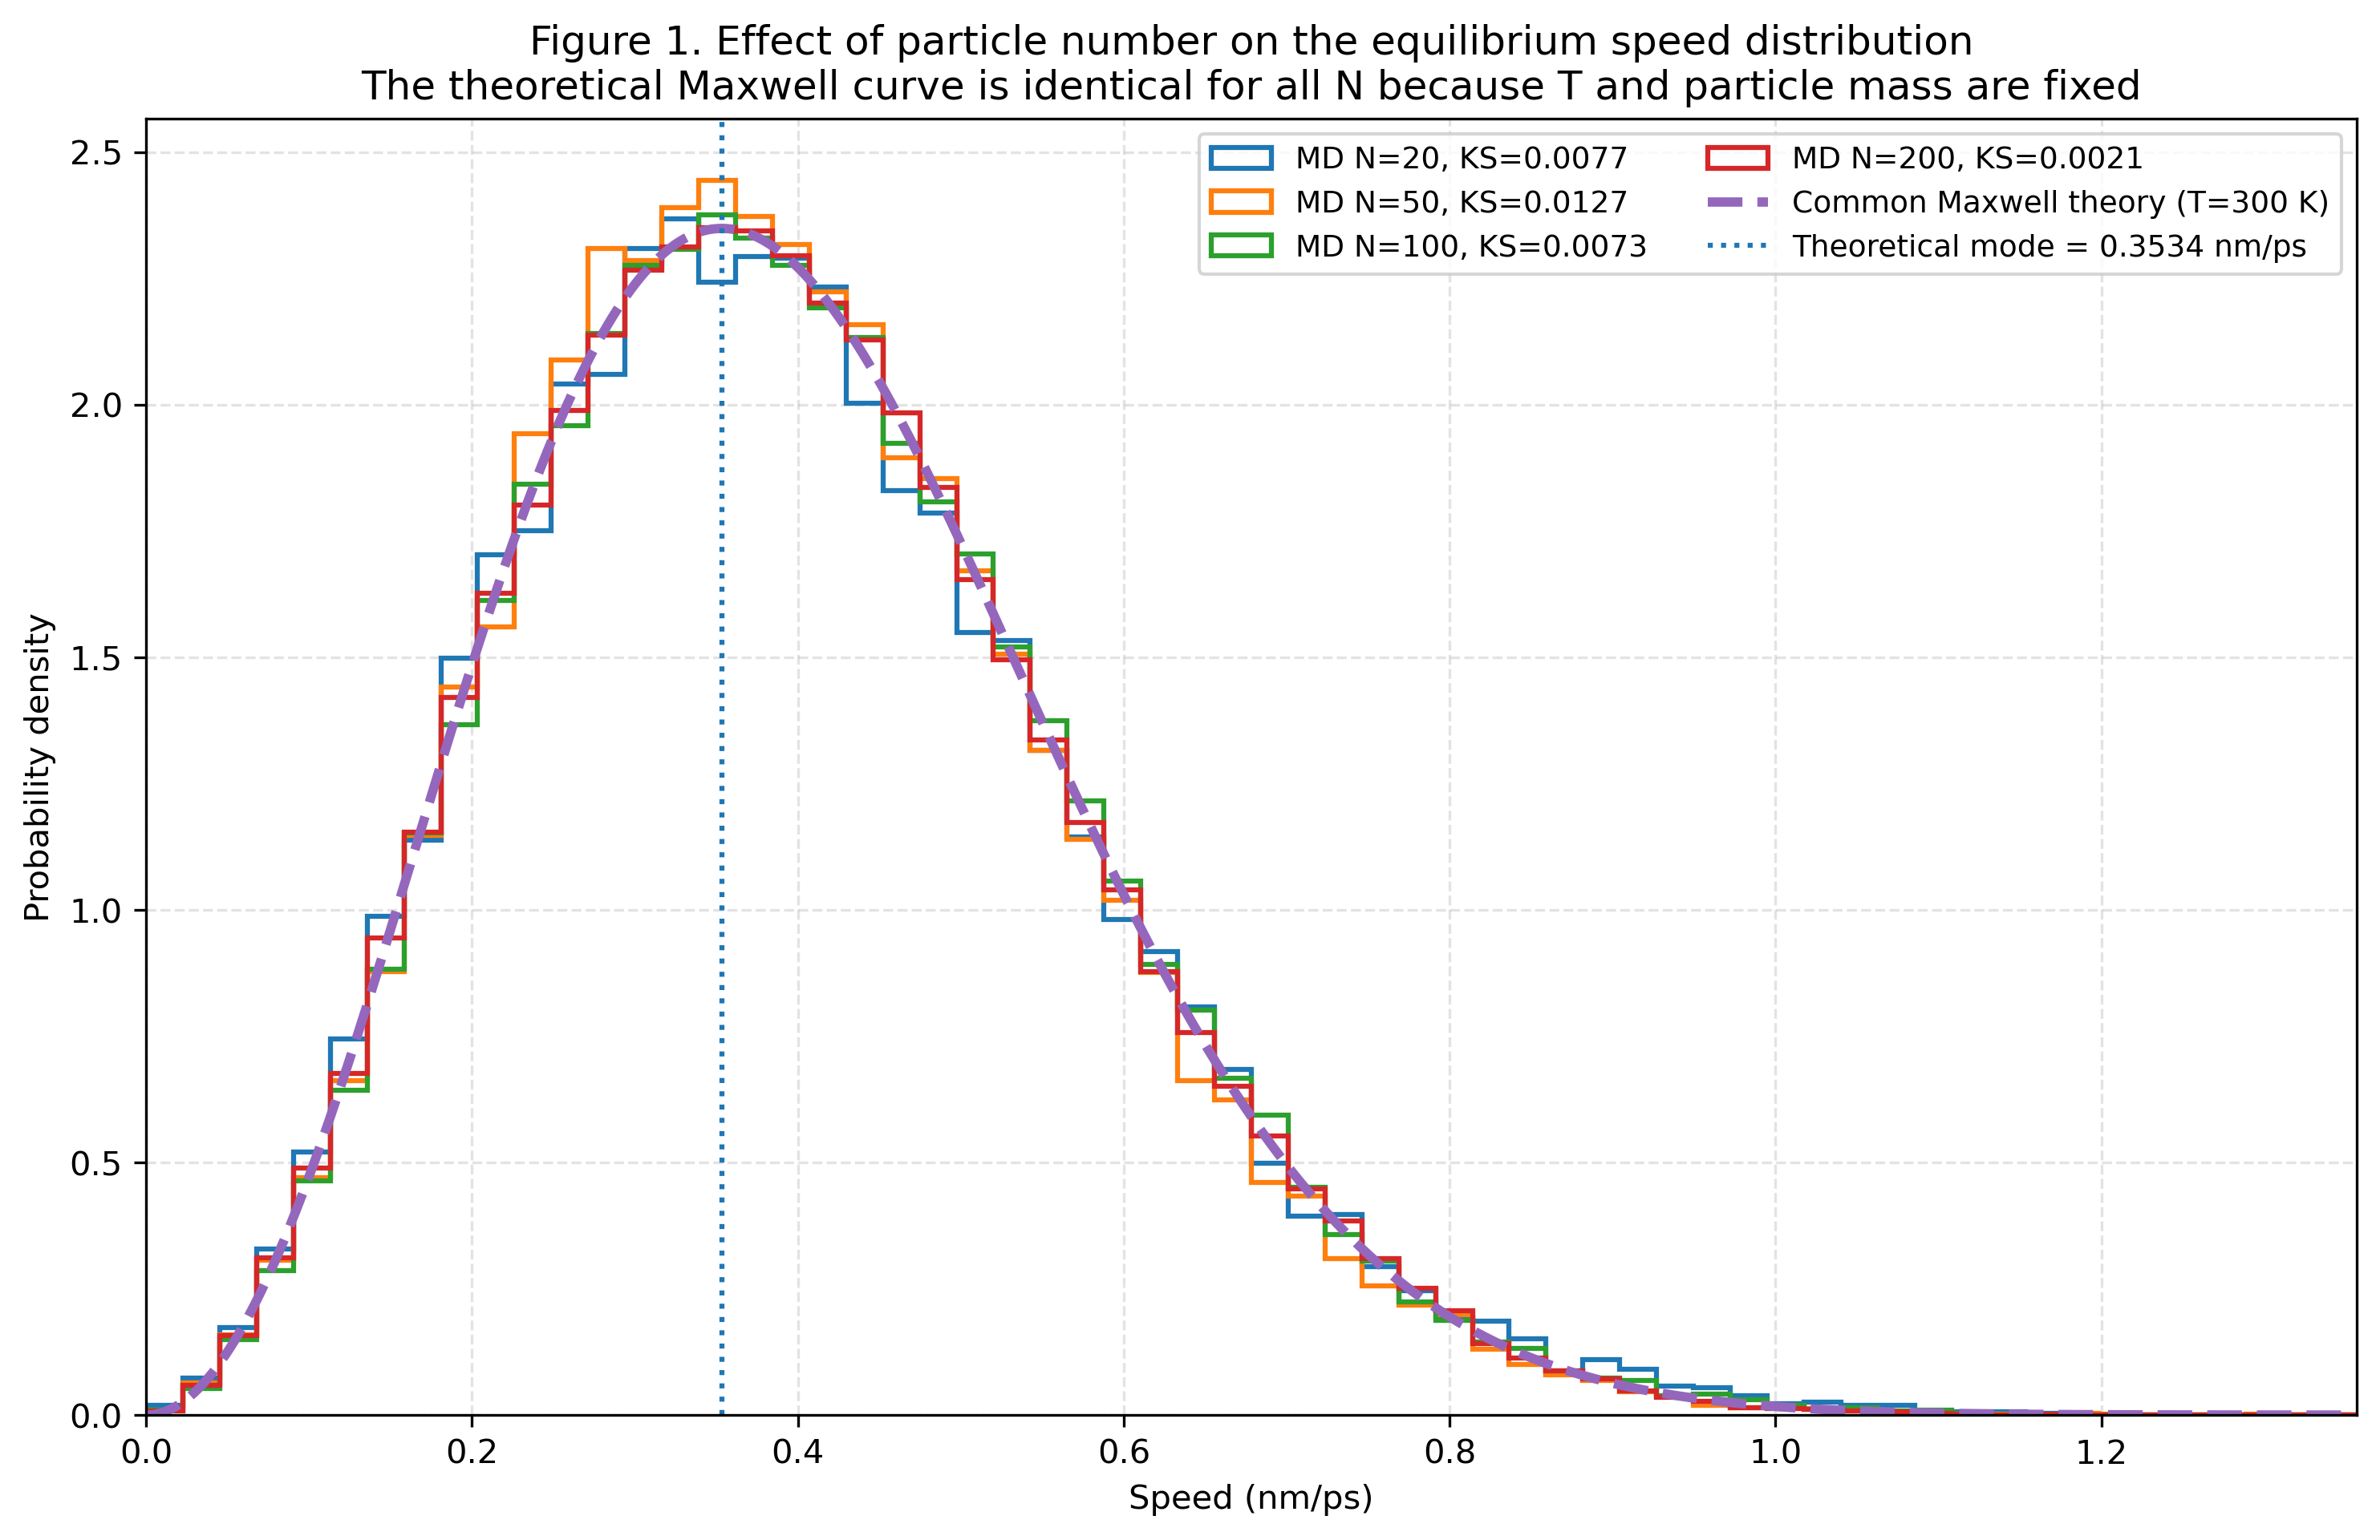



3.3. Effect of Particle Number
The theoretical Maxwell speed distribution is
with
Therefore, at fixed temperature and for the same particle species, changing the number of particles should not change the theoretical Maxwell speed distribution.
After proper equilibration, the density change should not alter the functional form of the theoretical Maxwell velocity distribution.
This density change may affect:
the collision frequency;
the time required to reach equilibrium;
the velocity autocorrelation;
the correlation between adjacent trajectory frames.

Slide 9
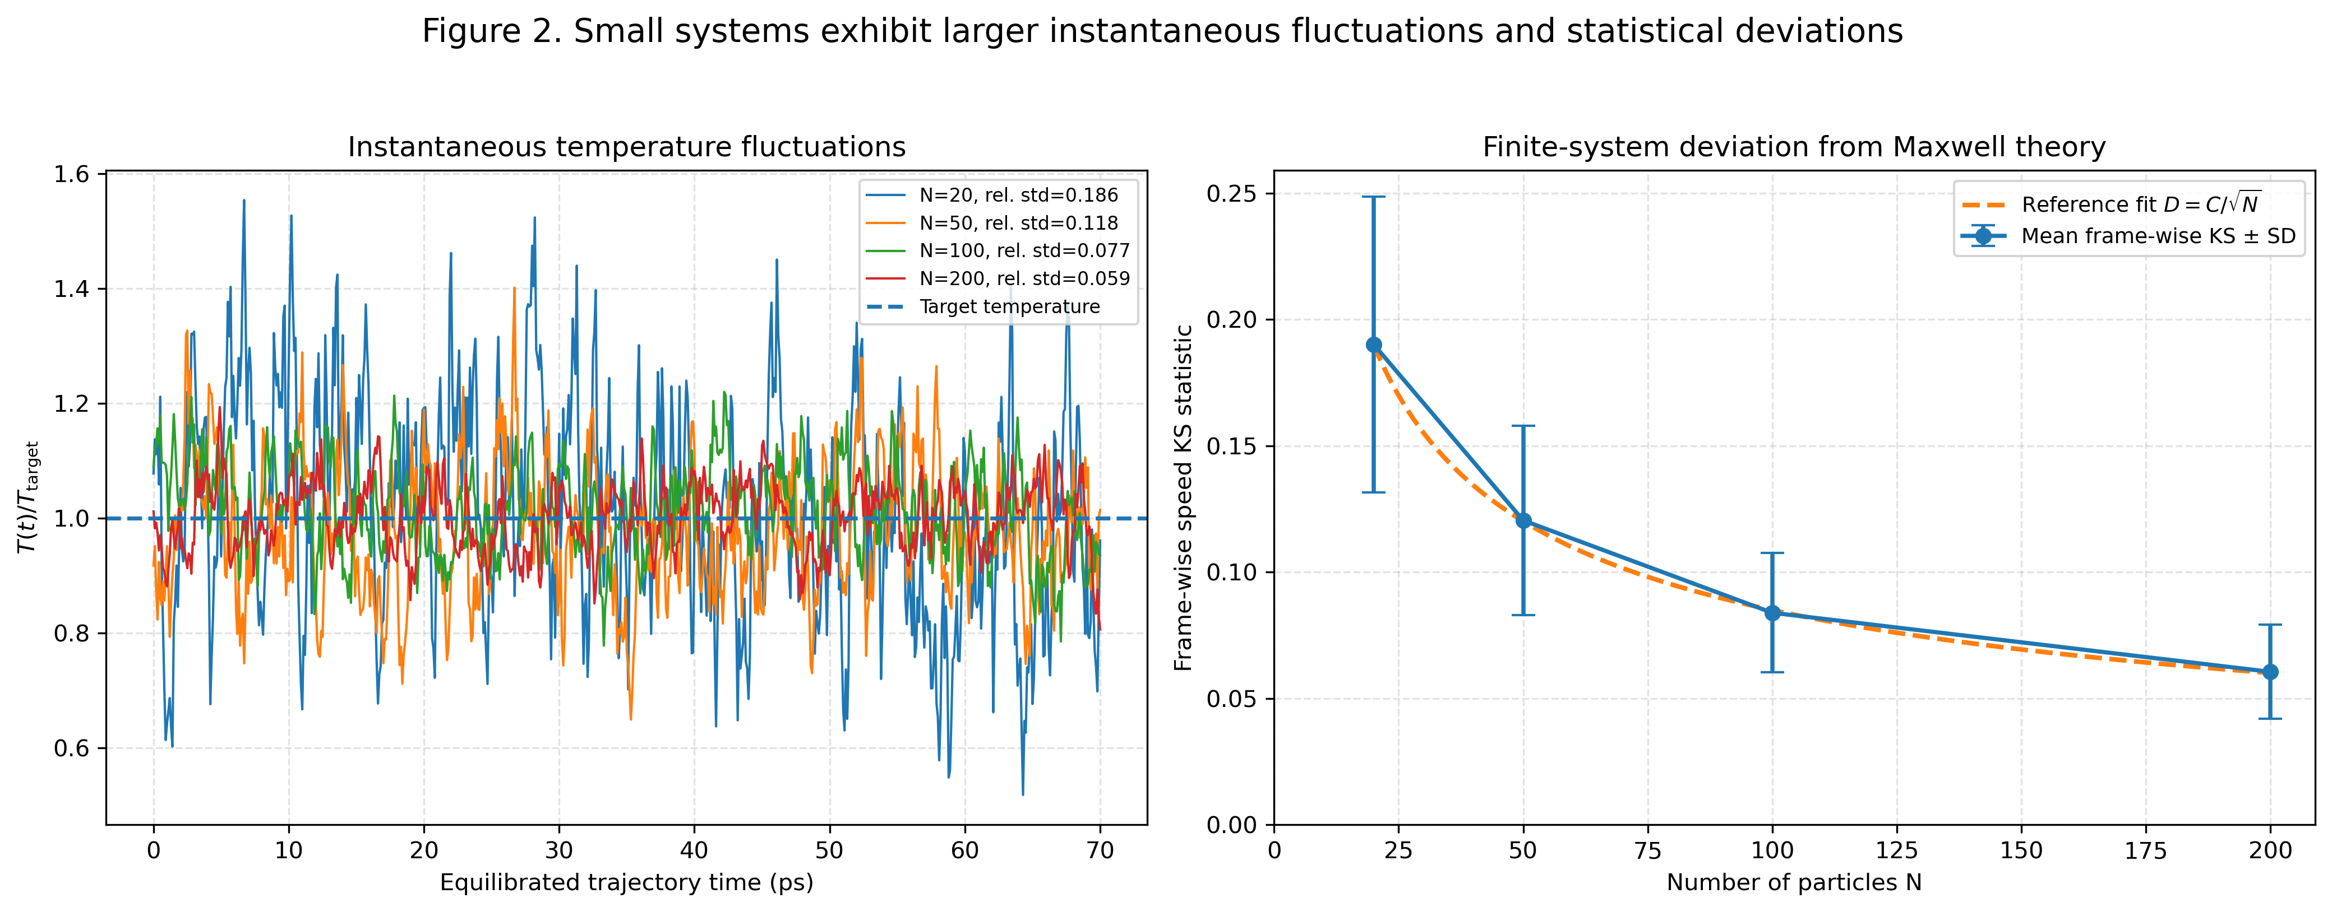




3.3. Effect of Particle Number_Small system
Smaller systems are nevertheless expected to exhibit more pronounced statistical noise and larger instantaneous fluctuations.
Upper panel: instantaneous temperature fluctuations
The instantaneous kinetic energy is
The instantaneous temperature is
For a canonical system with 3N kinetic degrees of freedom, the relative temperature variance is expected to satisfy
Lower panel: frame-wise KS deviations
For ordinary finite sampling, the statistical error is generally expected to scale approximately as

Slide 10
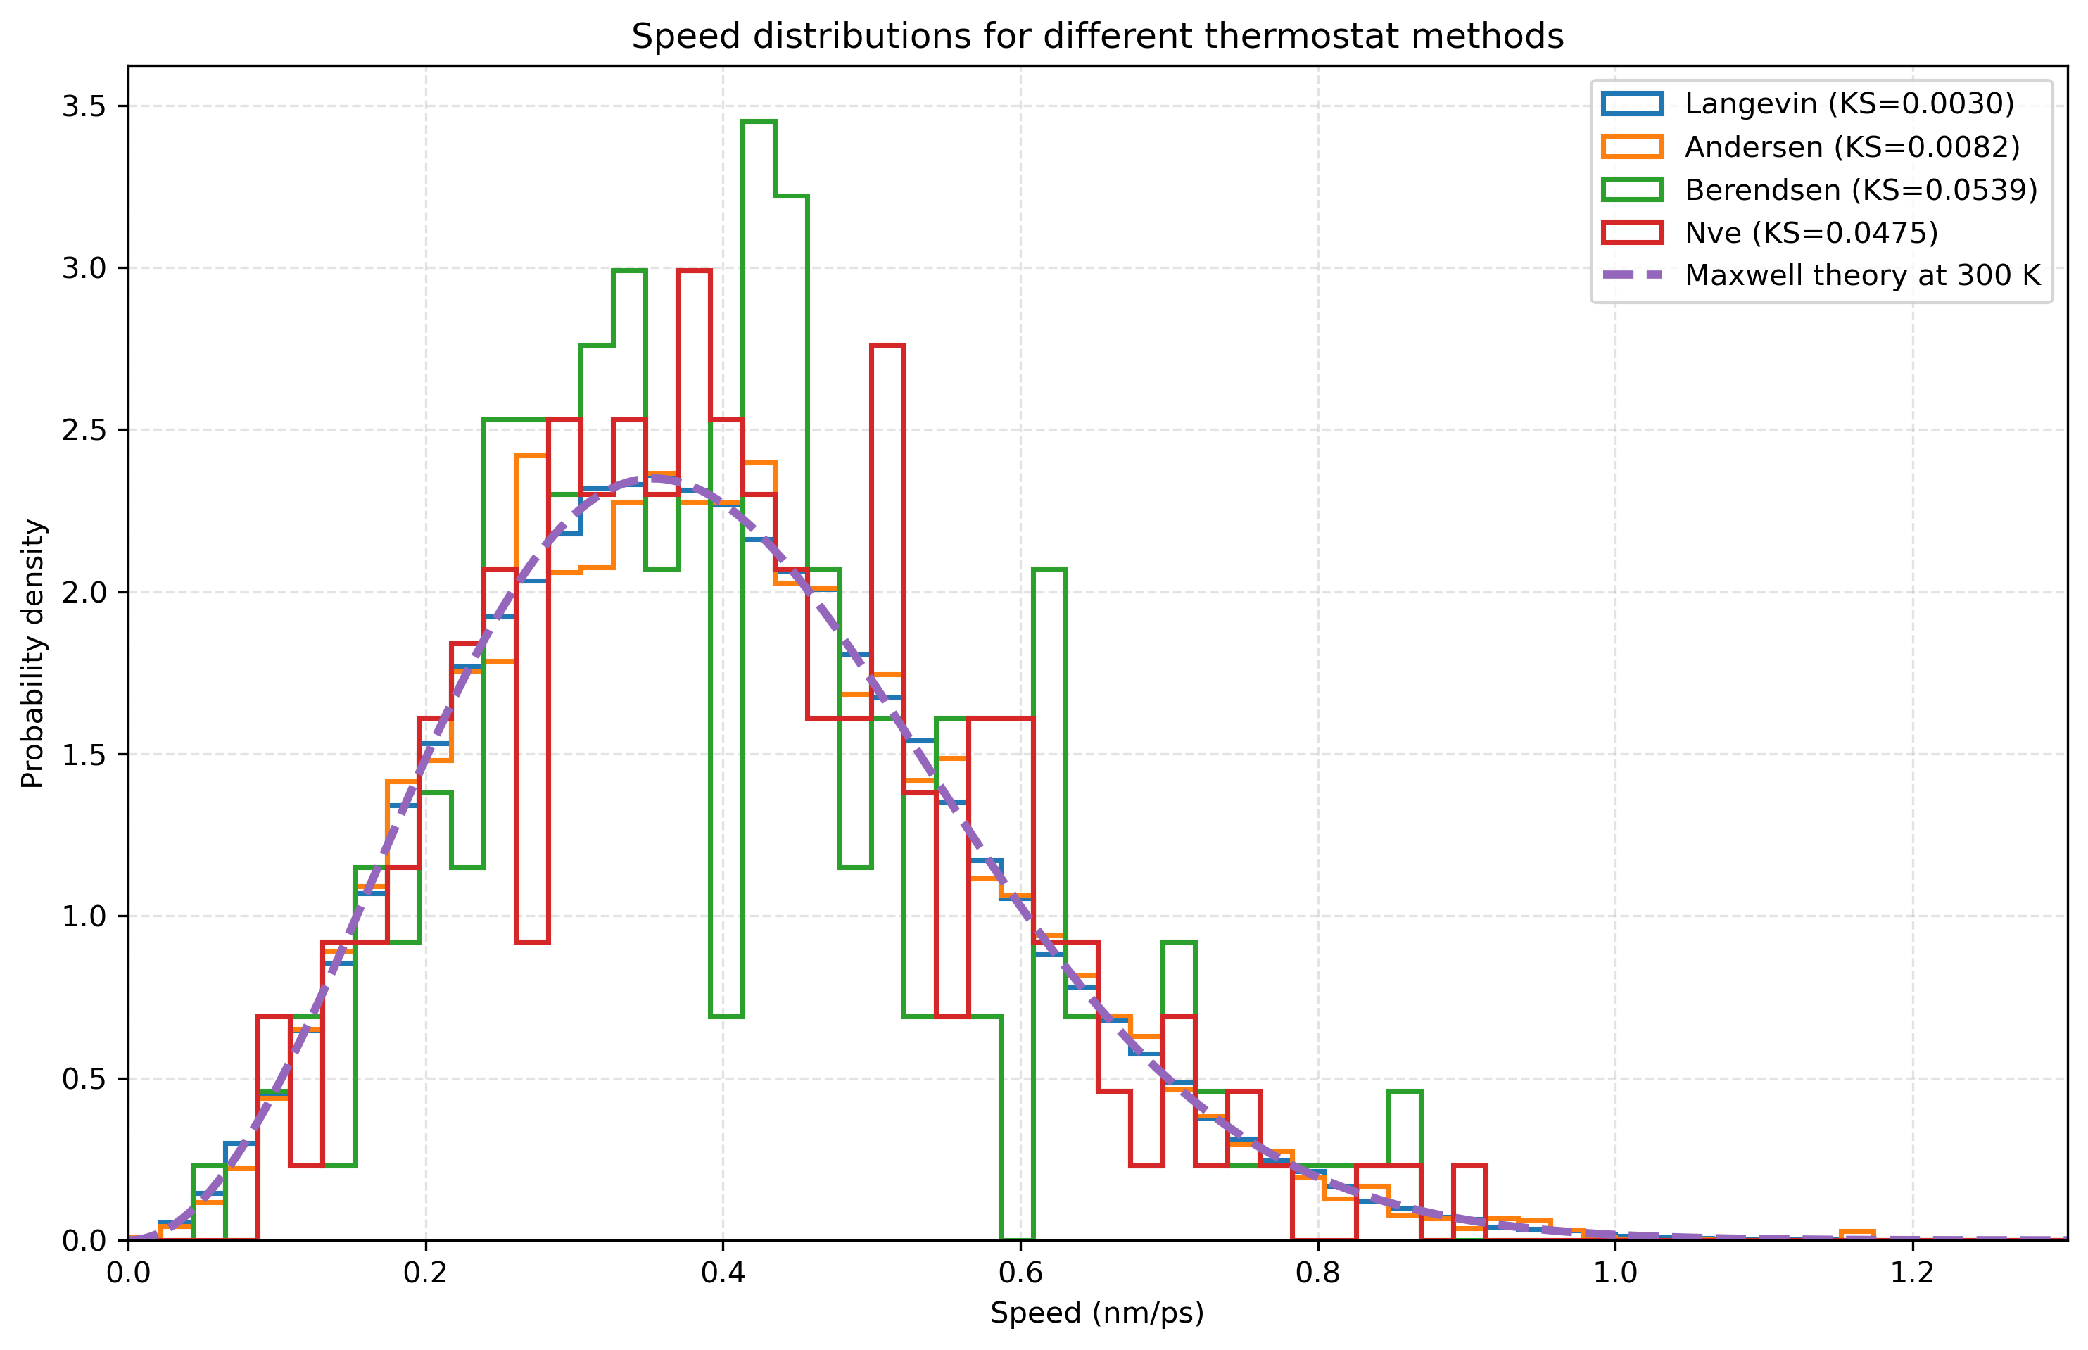



3.4. Thermostat Effects
The speed of each particle was calculated from its Cartesian velocity components:
The resulting speed histogram was then compared with the theoretical Maxwell distribution at 300 K:
Here,
The Langevin thermostat produces a speed distribution close to the theoretical Maxwell curve.
The Andersen thermostat generates the correct equilibrium speed distribution.
Based only on the speed histogram, one might incorrectly conclude that the Berendsen thermostat is also correct.
NVE is not a thermostat. Since the initial velocities are sampled from a Maxwell–Boltzmann distribution, the speed distribution may retain an approximately Maxwellian shape for a long time.

Slide 11
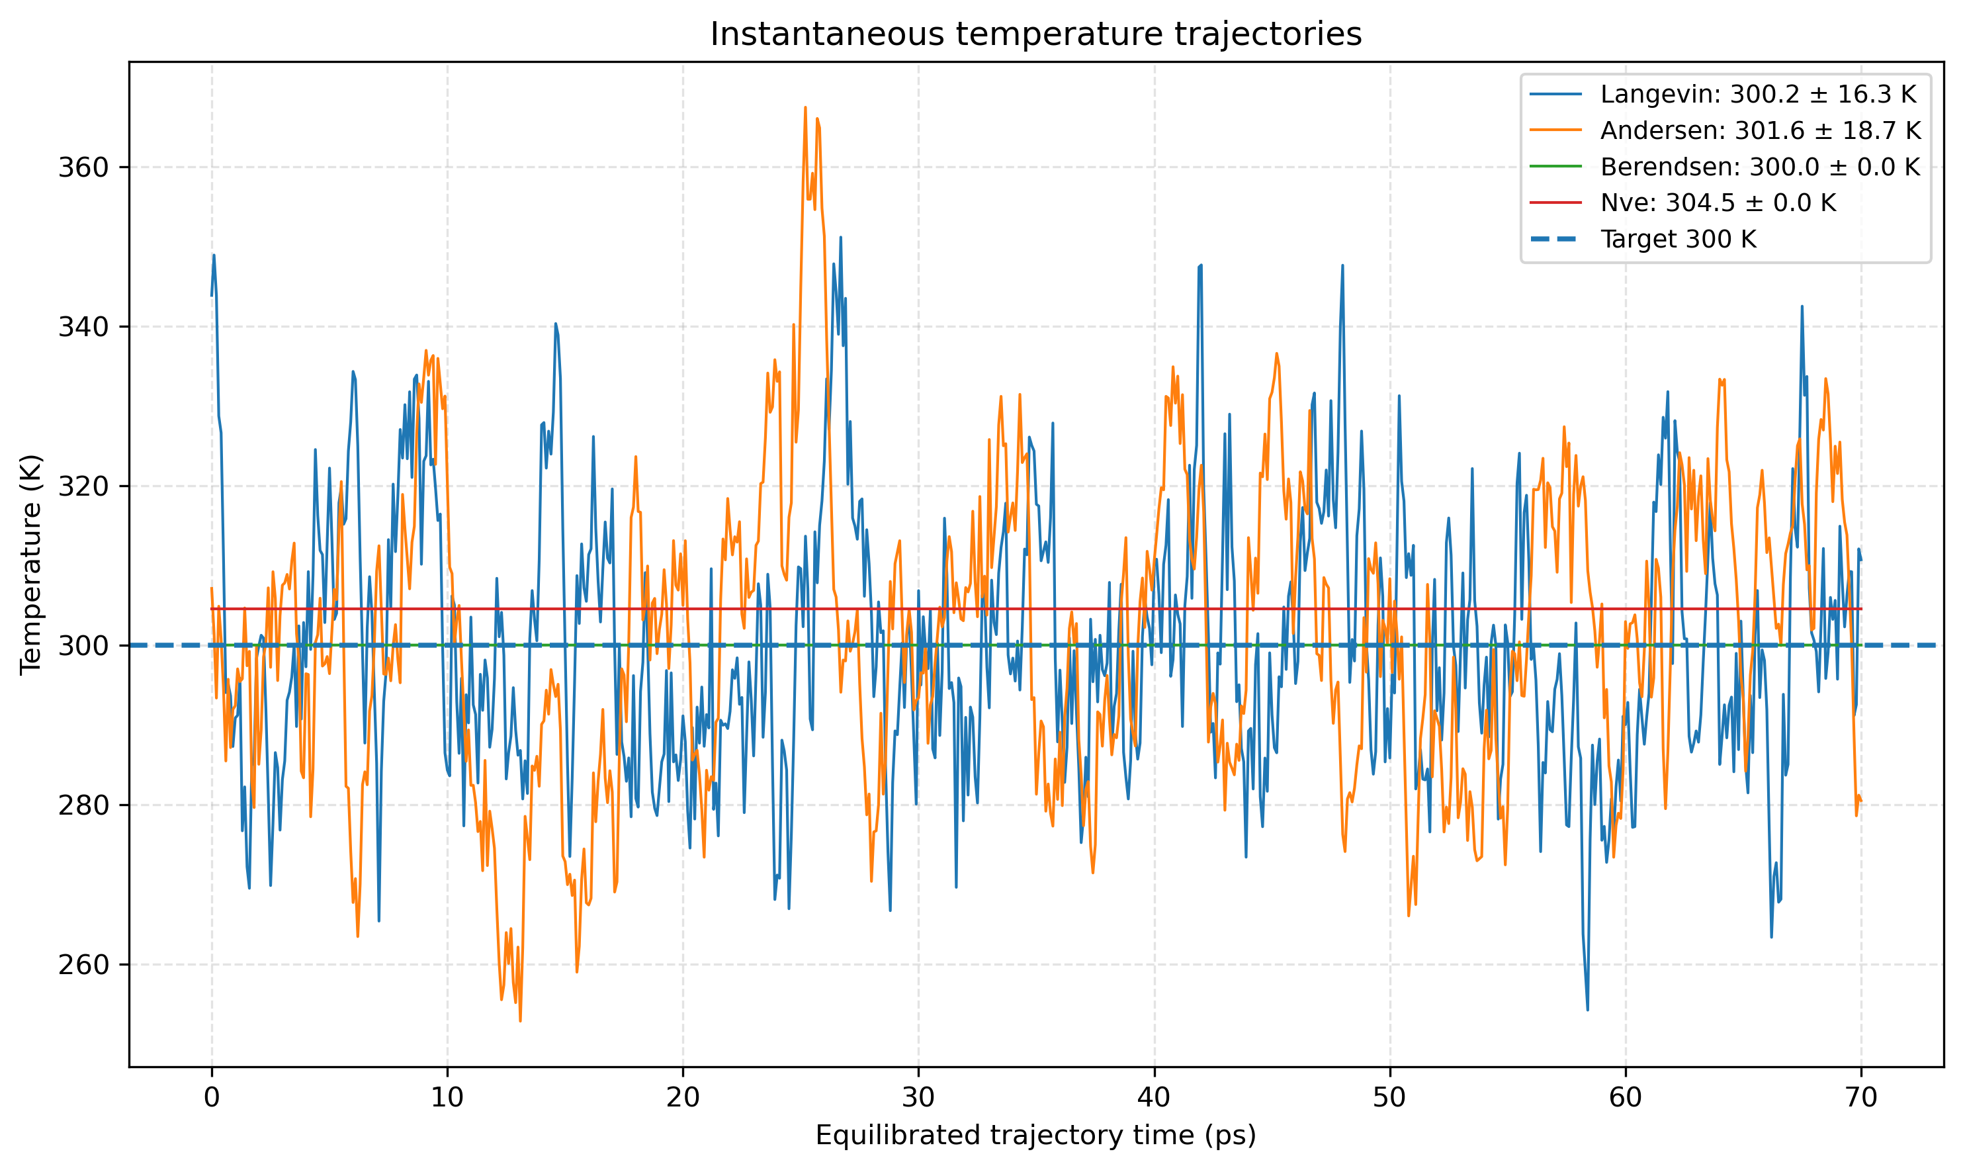



3.4. Thermostat Effects
The relative variance of the instantaneous temperature is
The relative standard deviation is therefore
For
Langevin：The instantaneous temperature fluctuates randomly around 300 K.
Andersen：The temperature also fluctuates around 300 K. The trajectory may appear more discontinuous than that obtained with Langevin because particle velocities are randomly resampled after collisions with the fictitious heat bath.
Berendsen：The temperature is tightly driven towards 300 K. The trajectory is therefore much smoother, and the temperature fluctuations are strongly suppressed.
NVE：There is no target-temperature control. Because the simulation box is very large and the gas is extremely dilute, the kinetic energy may remain nearly constant over a long period, resulting in very small temperature fluctuations.

Slide 12
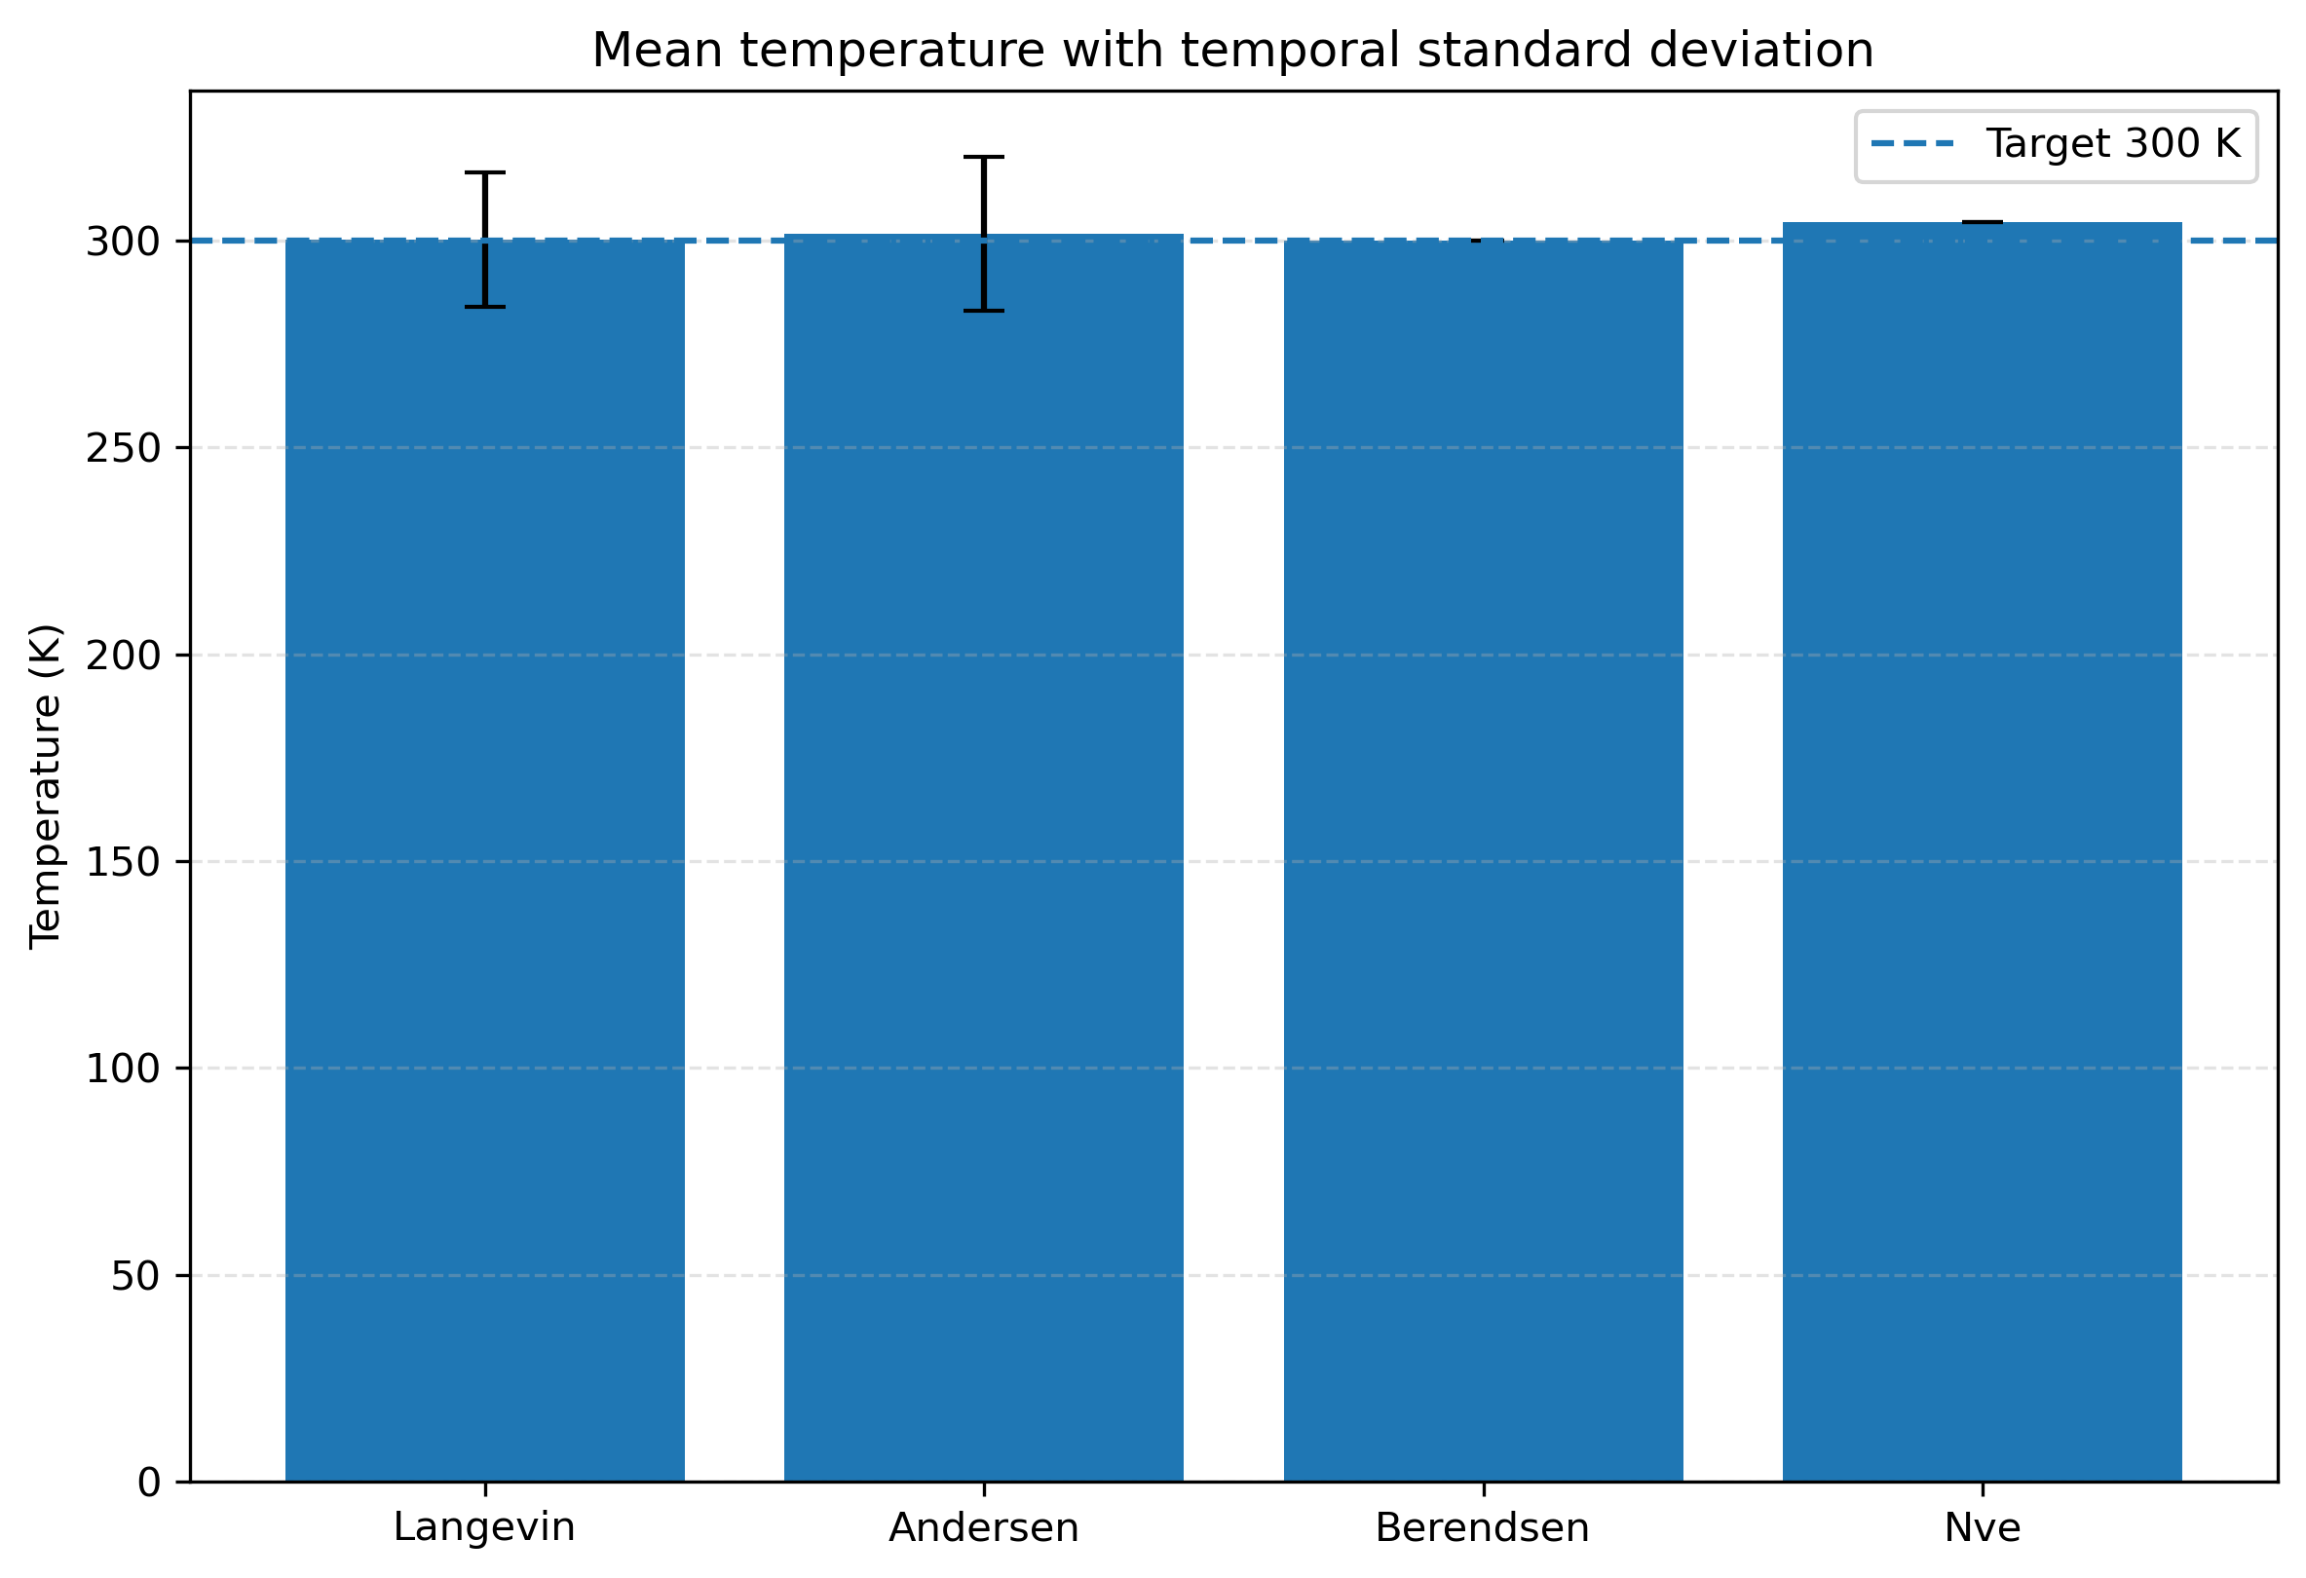
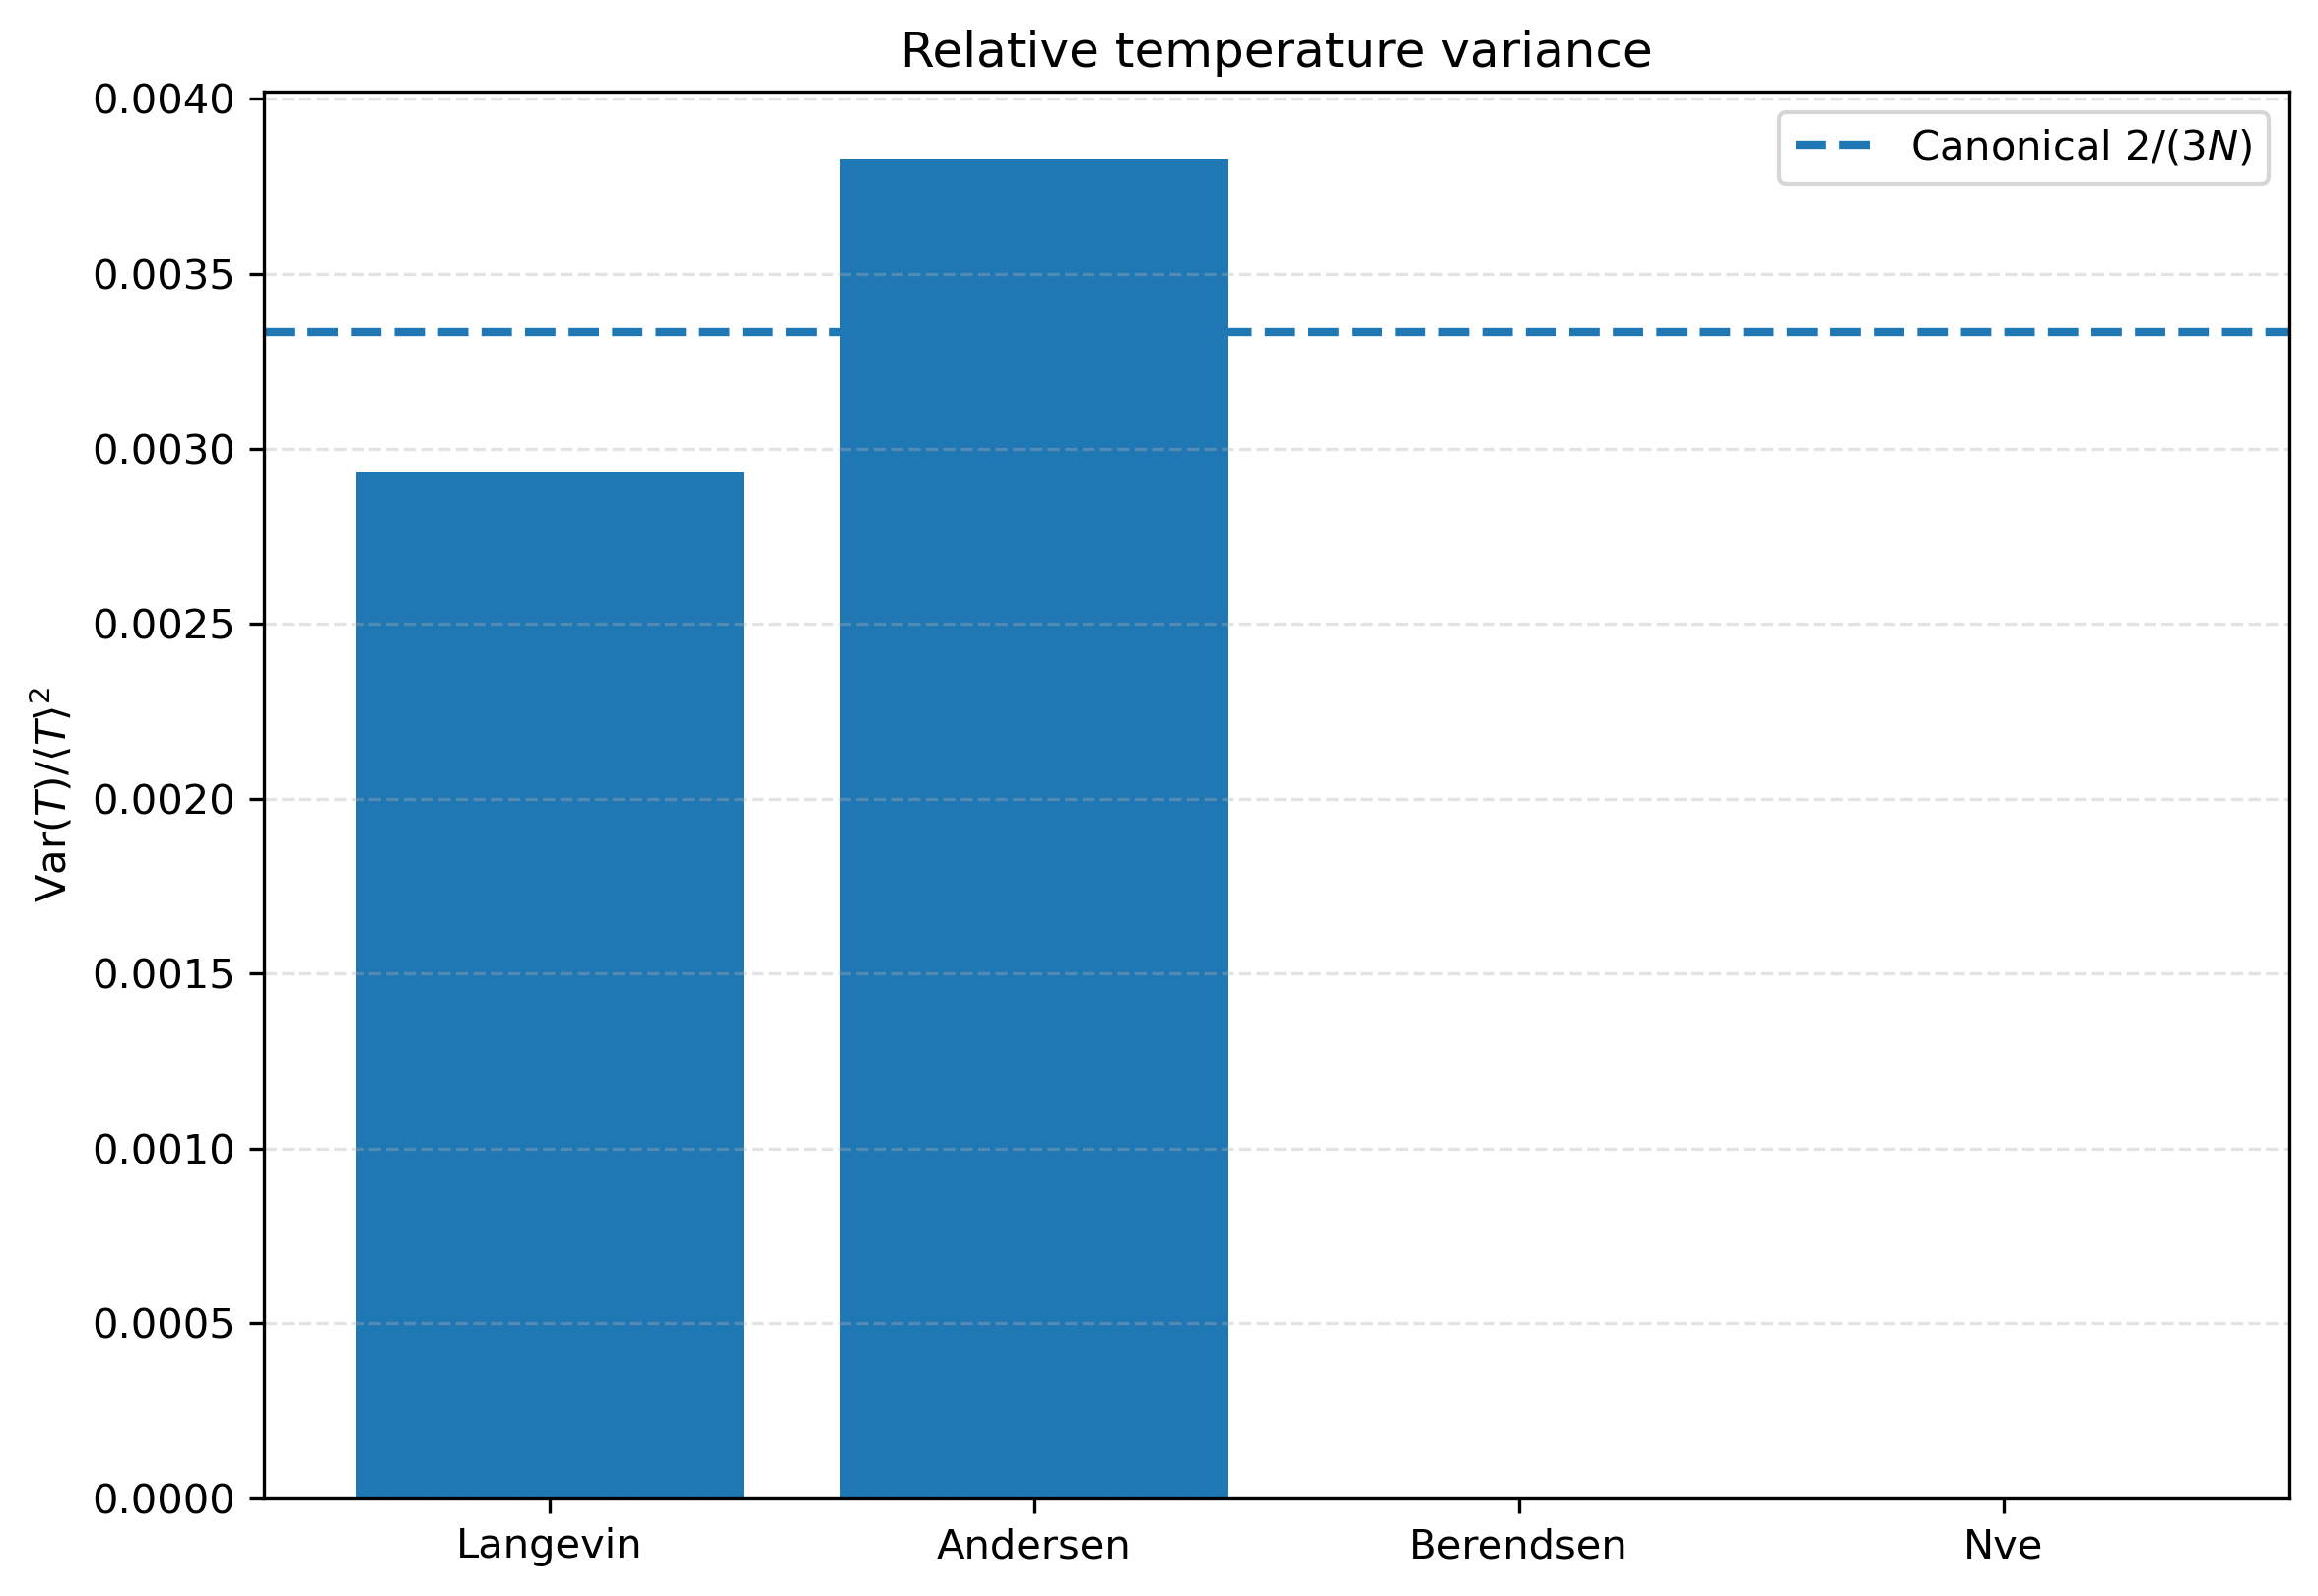
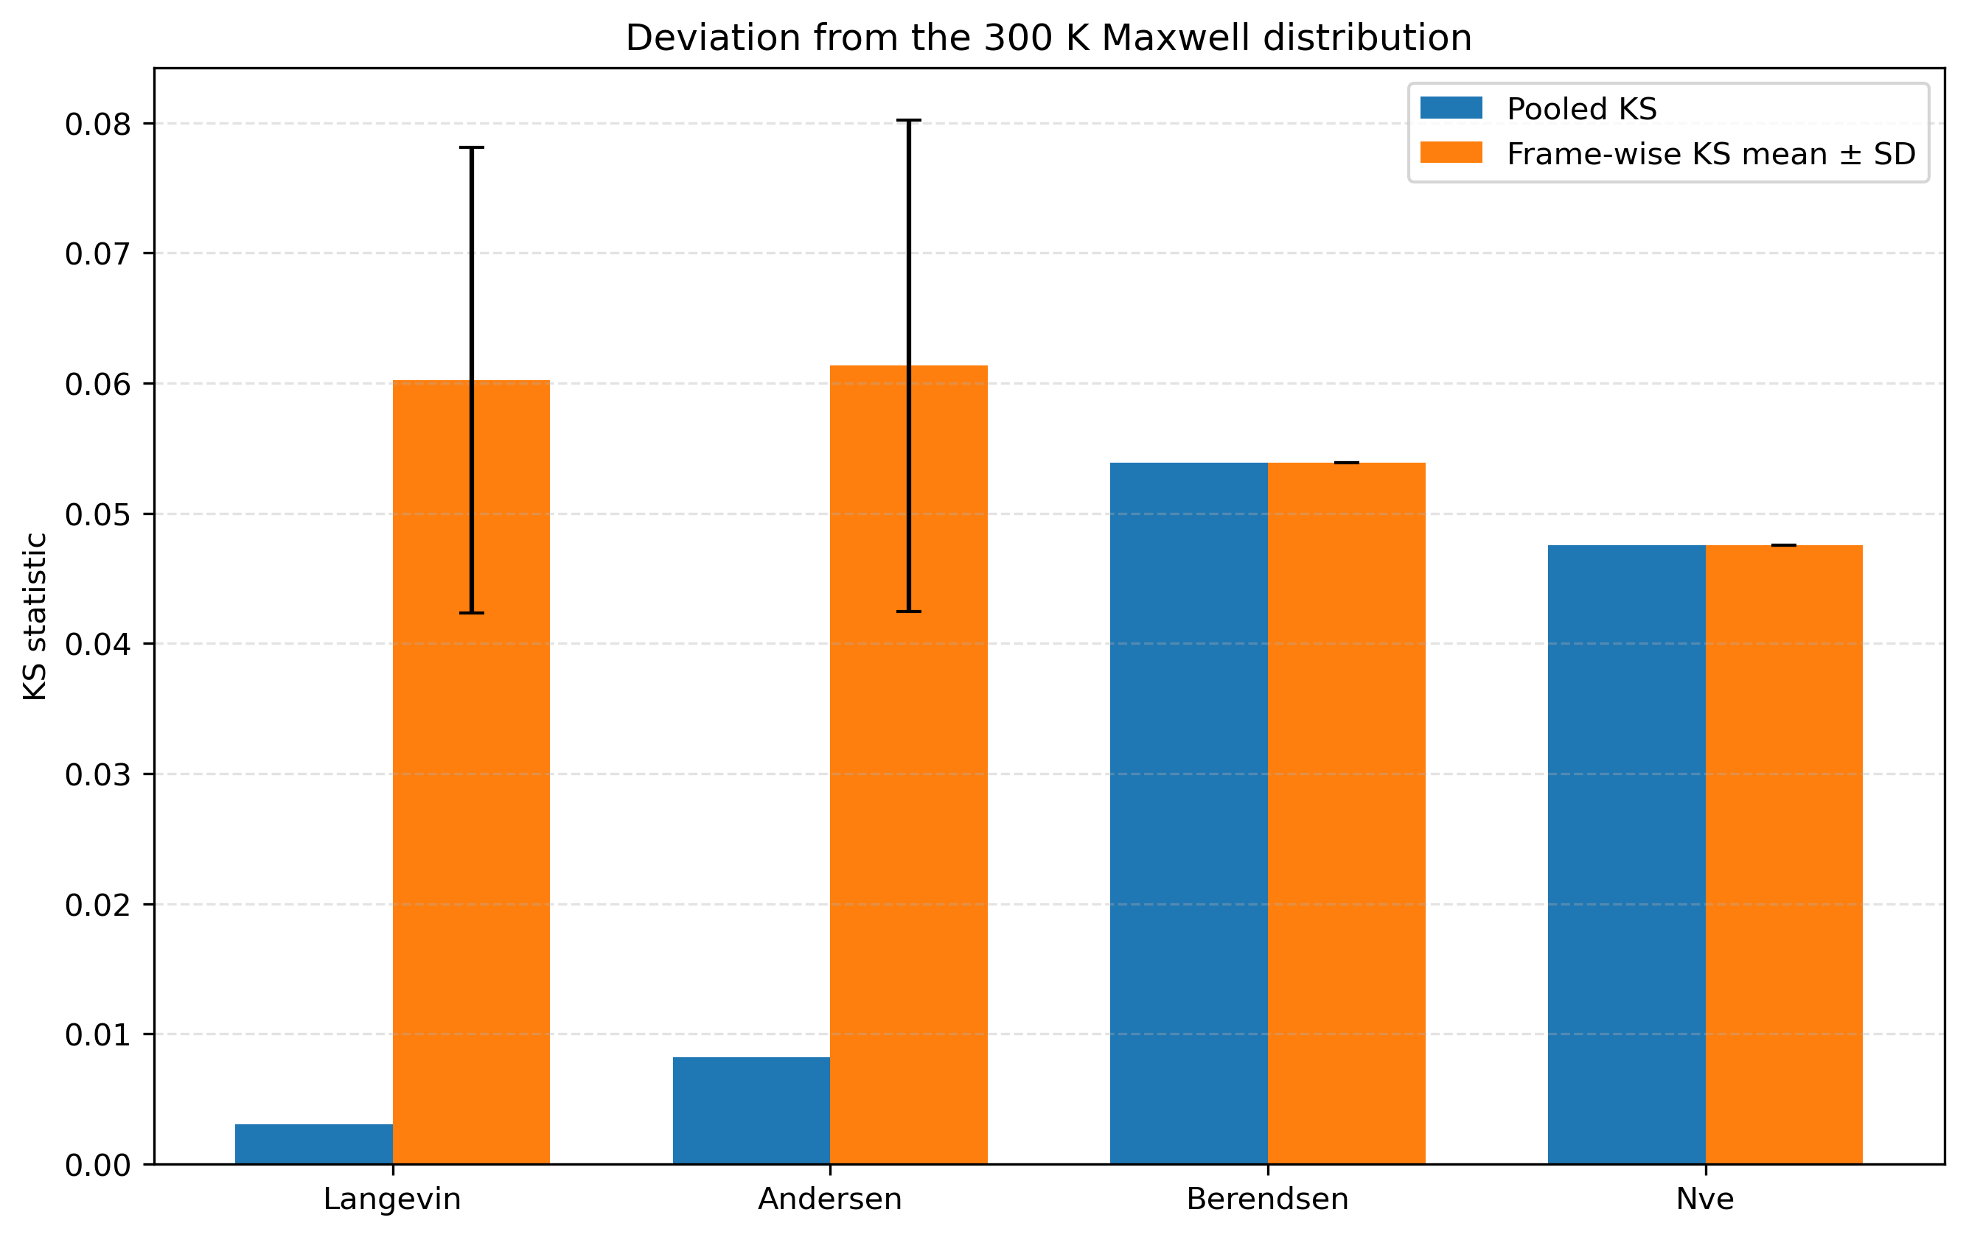




3.4. Thermostat Effects
Mean temperature with temporal standard deviation
The Berendsen thermostat drives the temperature too tightly towards the target value, significantly suppressing the natural fluctuations in kinetic energy and temperature.
NVE has no heat bath; therefore, its temperature is determined by the initial total energy.
Relative temperature variance
The relative temperature variance obtained with the Berendsen thermostat is nearly zero. This clearly shows that Berendsen strongly suppresses temperature fluctuations and therefore does not generate a strictly correct canonical ensemble.
KS comparison
The larger error bars in the frame-wise KS statistics for Langevin and Andersen arise because their velocity distributions and temperatures undergo genuine temporal fluctuations.
In contrast, the frame-wise KS statistics for Berendsen and NVE remain nearly constant, indicating that their velocity distributions change very little over time. However, this does not imply that they provide more accurate ensemble sampling.

Slide 13
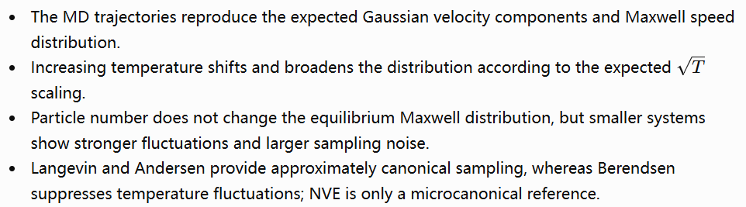
4. Main conclusions

Slide 14
Thanks for your attention.
Yuxuan Zhang
Yiyi Liang
29.07.2026

